Slide 1


Florian Henkes – Technical University of Munich
Oliver Schulz – Max-Planck Institute for Physics
Julia HEP Workshop 2025– Princeton University

Slide 2
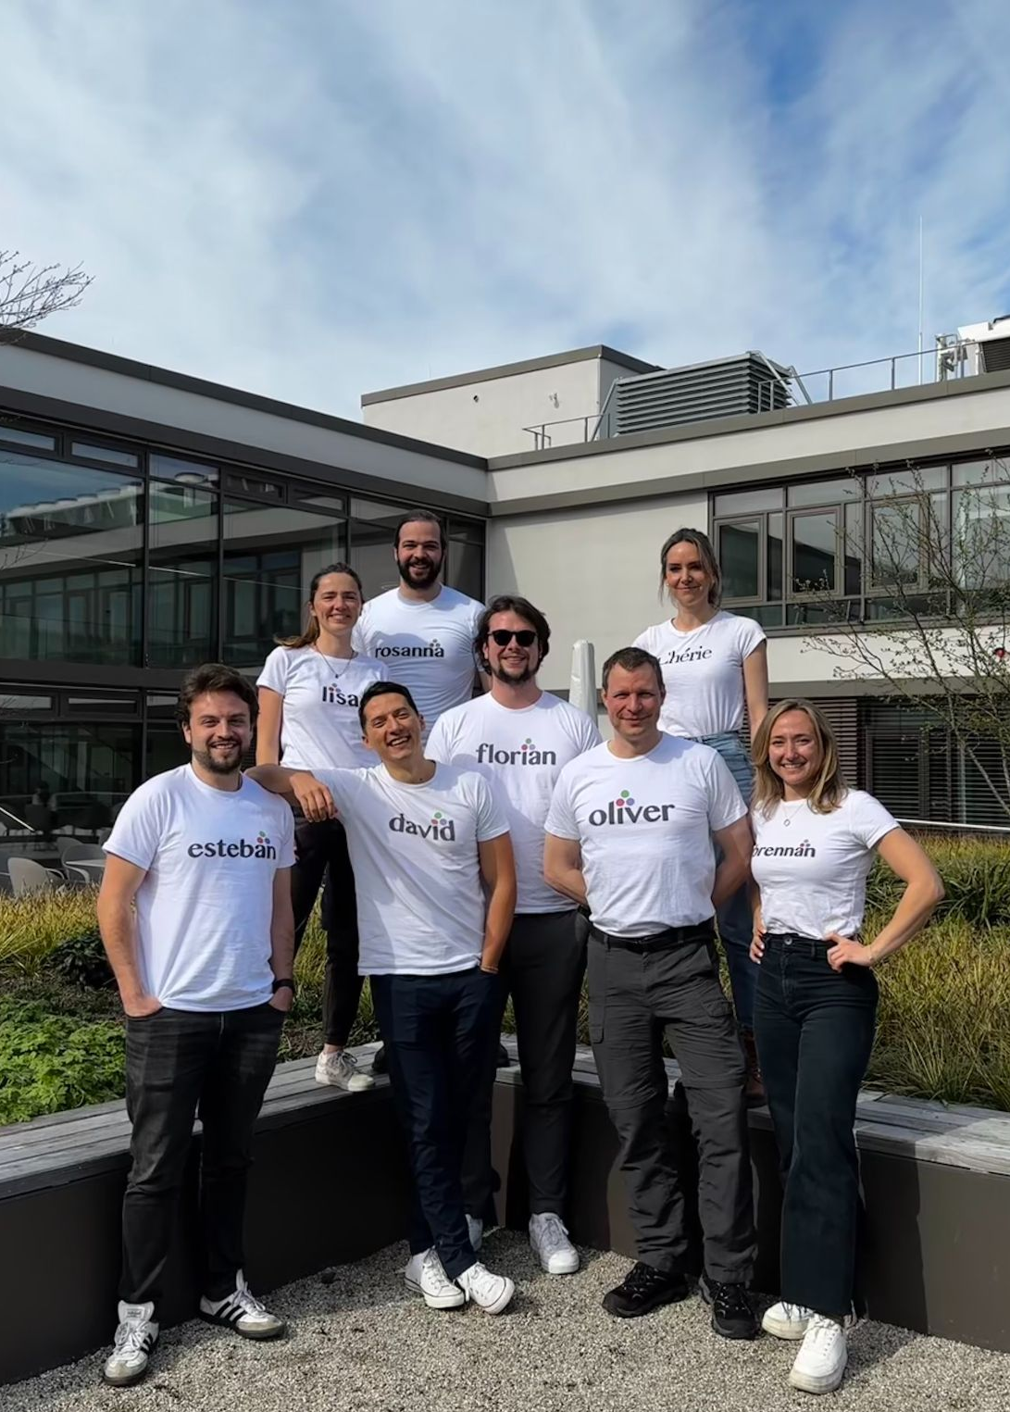
Outline
Introduction to LEGEND and 0νββ-decay physics
What is the JuLeAna Software Stack?
Features and highlights in the latest LEGEND analysis
Summary & Outlook

Slide 3
Outline
Introduction to LEGEND and 0νββ-decay physics
What is the JuLeAna Software Stack?
Features and highlights in the latest LEGEND analysis
Summary & Outlook

Slide 4
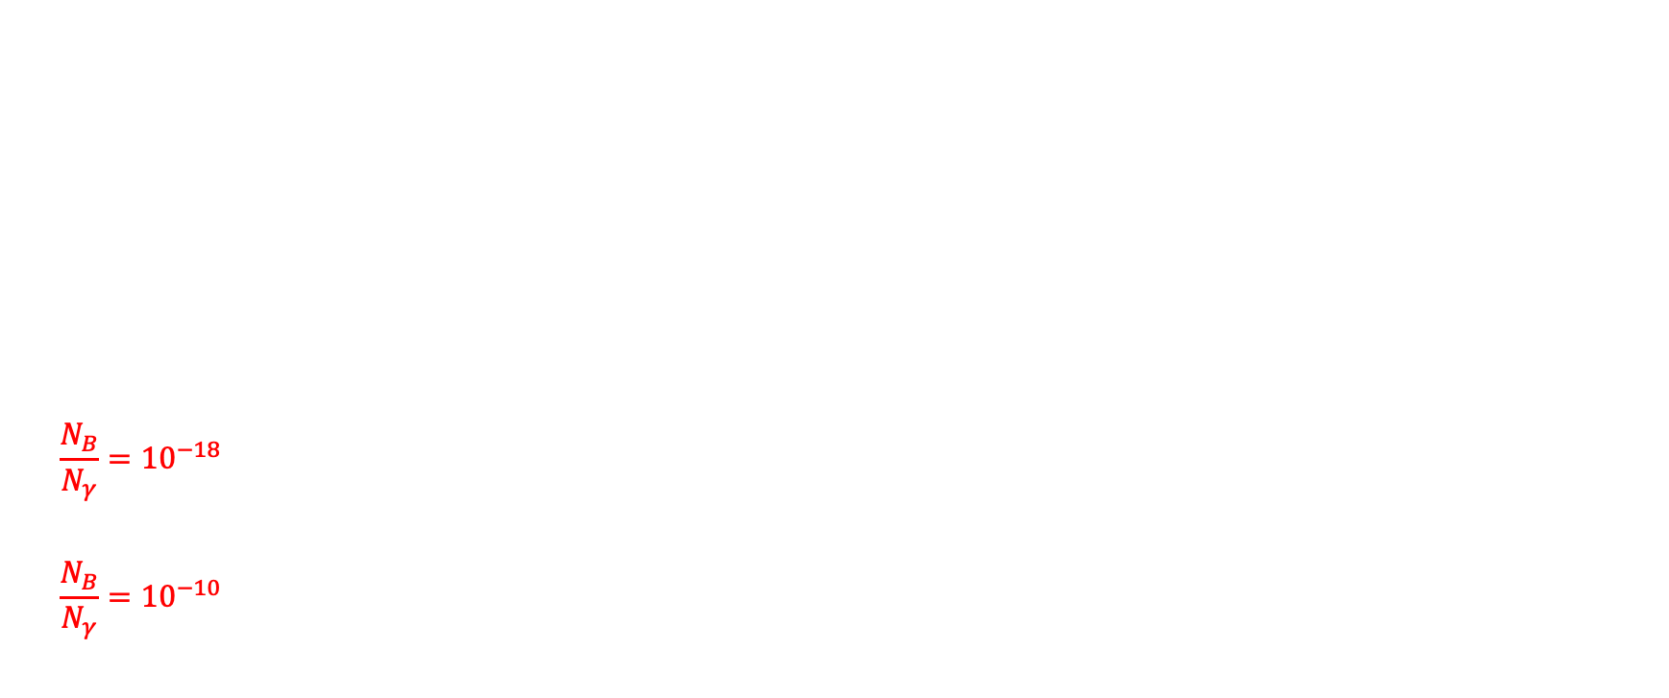
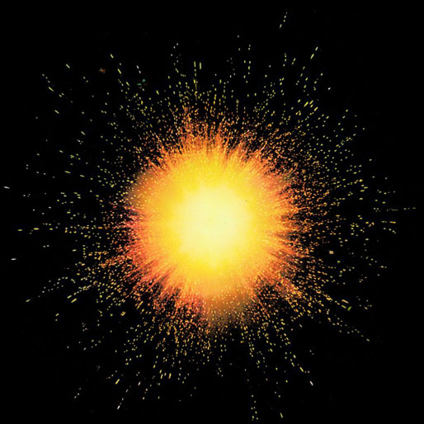
Matter Antimatter Asymmetry
-
+
-
-
+
+

Slide 5
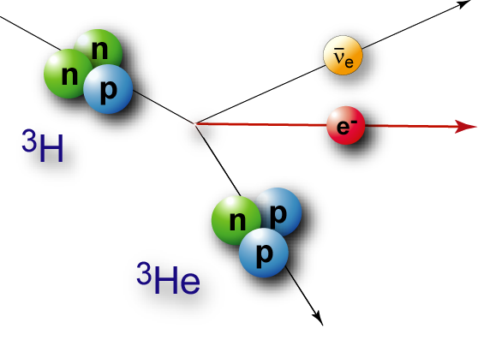
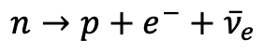
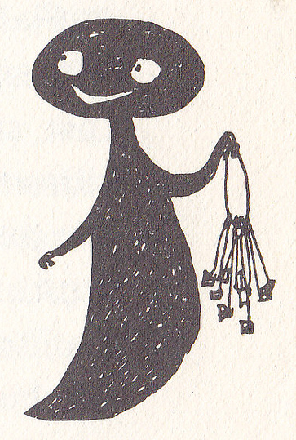




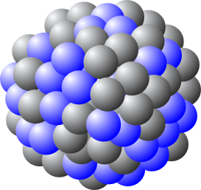

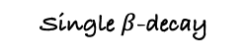
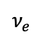
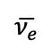
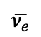
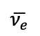
Neutrinoless Double Beta Decay
* Only Possible in ~35 isotopes
$$\overline{ν_{e}}$$
$$\overline{ν_{e}}$$
Single $β$-decay
BSM physics
“Creation of matter without anti-matter”
$$\overline{ν_{e}}$$
$$ν_{e}$$
2νββ
0νββ
→ Lepton-Number Violation (LNV) by two units
→ Neutrino = Majorana
→ Matter-antimatter asymmetry explanation?

Slide 6
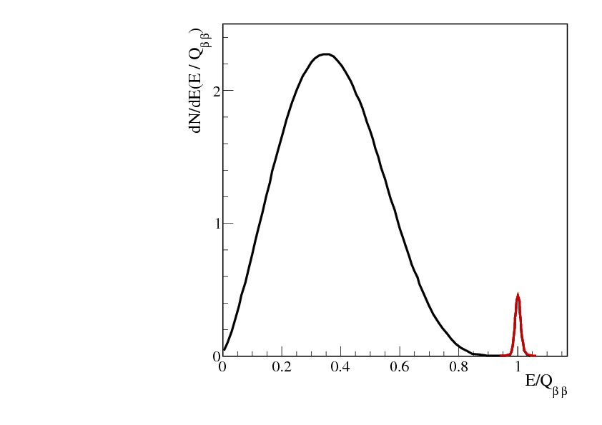
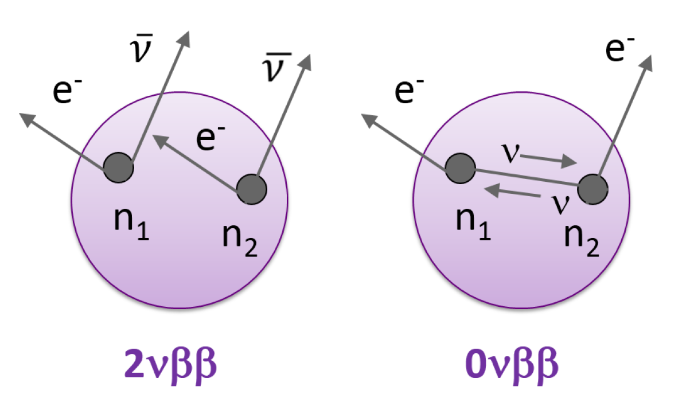

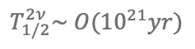
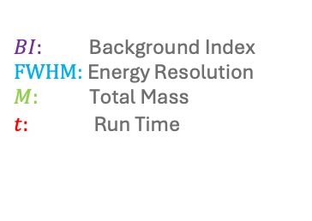
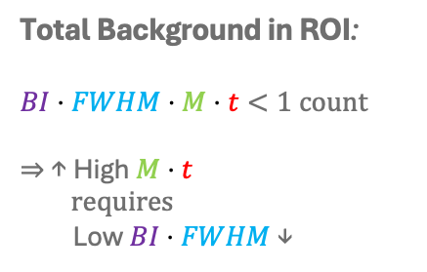
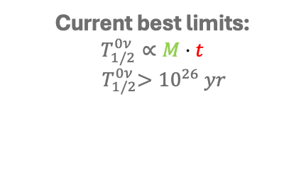
The challenge: Low Statistics
Continuous energy spectrum
Current best limits:
$$T_{1/2}^{0ν}∝M⋅t$$
$${ T}_{1/2}^{0ν}>{10}^{26} yr$$
Total Background in ROI:
$$BI⋅FWHM⋅M⋅t<1 count$$
⇒ ↑ High $M⋅t$
requires
Low$BI⋅FWHM$ ↓
$$T_{1/2}^{2ν}\sim O({10}^{21}yr)$$
Peak at Q_{𝛽𝛽} -value (⁷⁶Ge: 2.039 MeV)
$BI:$ Background Index
$FWHM:$ Energy Resolution
$M:$ Total Mass
$t:$ Run Time
Energy of both electrons
Notes:
Make 2 slides out of one

Slide 7
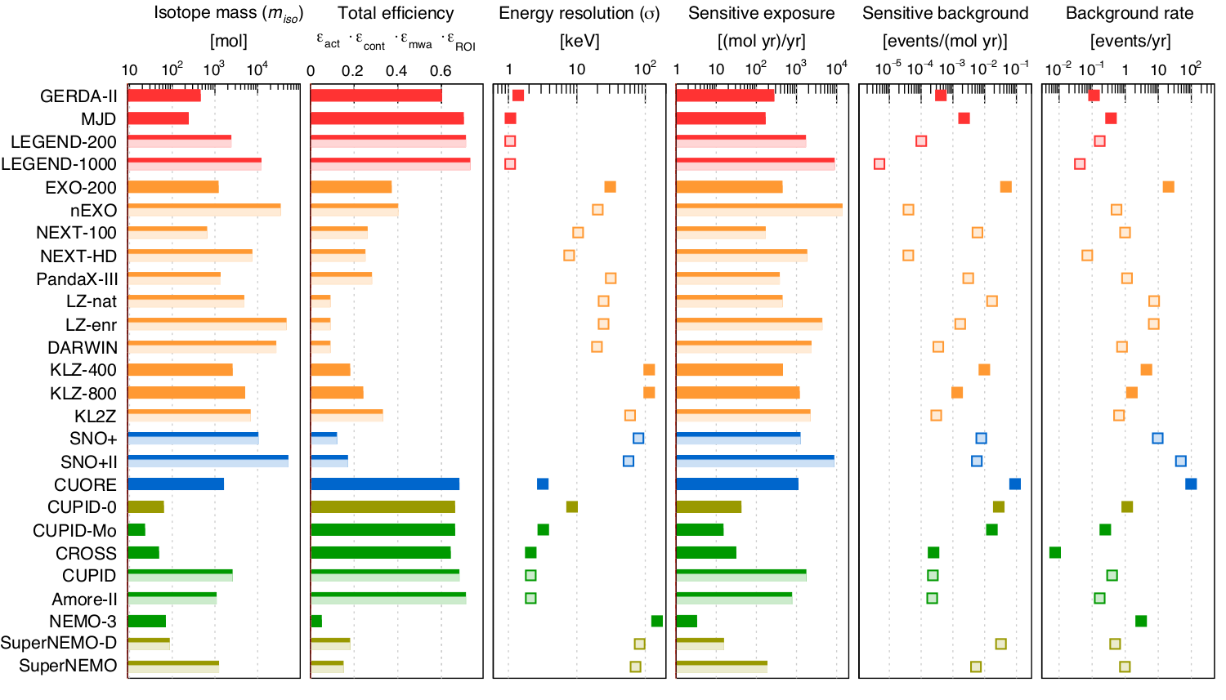
0νββ Decay Physics

Slide 8
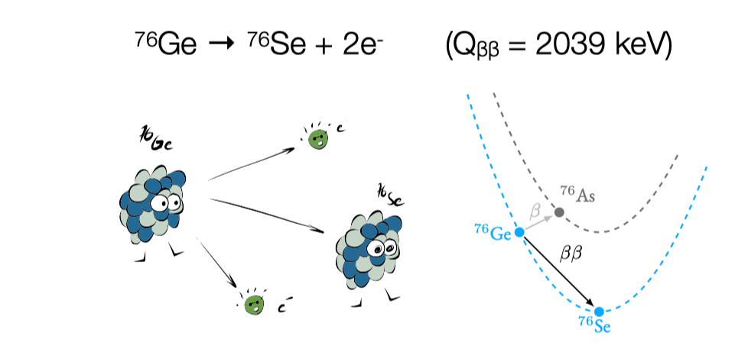
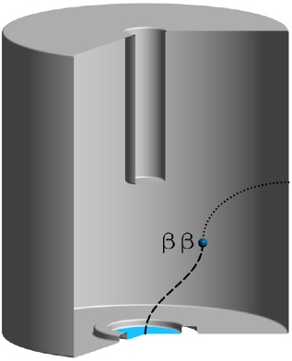

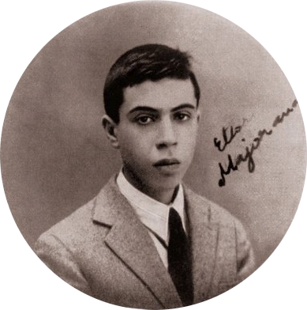
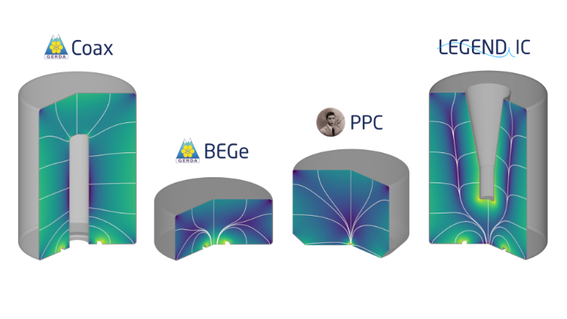
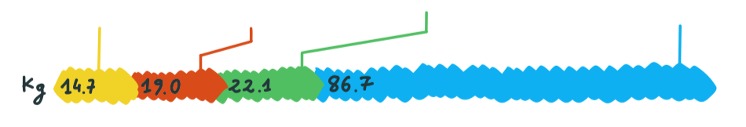
⁷⁶Ge: The ideal material?
Enriched ⁷⁶Ge bulk
n⁺ contact (lithiated) @ 3- 5 kV
High-Purity Germanium detectors enriched in ⁷⁶Ge
Source = detector ⟼ high efficiency
Intrinsically pure ⟼ low background
High enrichment (~90%) ⟼ high active mass
Ge crystal ⟼ excellent FWHM (~0.1%)
“solid-state TPC” ⟼ topological discrimination
⇒ Technology proven by GERDA and MAJORANA
Point-like ββ interactions
p⁺ contact (boron implanted)
Notes:
Make 2 slides out of one

Slide 9

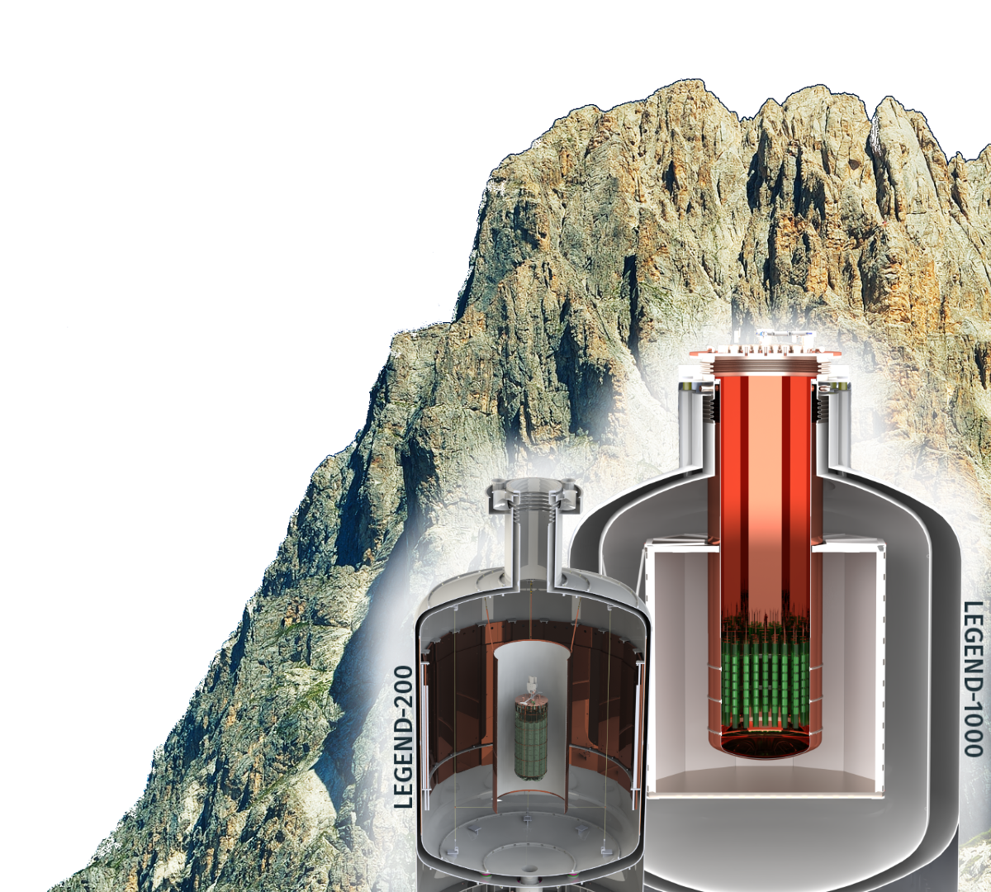
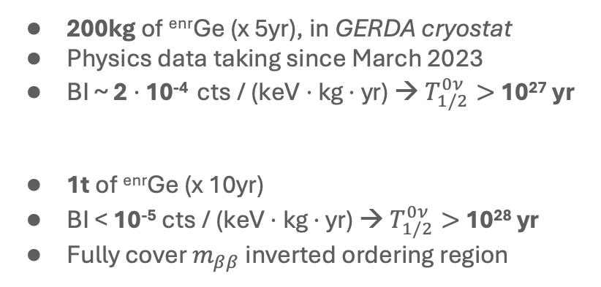
The - Experiment
“The collaboration aims to develop a phased,⁷⁶Ge-based
double-beta decay experimental program with discovery potential at a half-life beyond 10²⁸yr, using existing resources as
appropriate to expedite physics results.”
LEGEND-200
200kg of ^{enr}Ge (x 5yr), in GERDA cryostat
Physics data taking since March 2023
BI ~ 2 $⋅$ 10⁻⁴ cts / (keV $⋅$ kg $⋅$ yr) → $T_{1/2}^{0ν}>$ 10²⁷ yr
1t of ^{enr}Ge (x 10yr)
BI < 10⁻⁵ cts / (keV $⋅$ kg $⋅$ yr) → $T_{1/2}^{0ν}>$ 10²⁸ yr
Fully cover $m_{ββ}$ inverted ordering region
LEGEND-1000

Slide 10
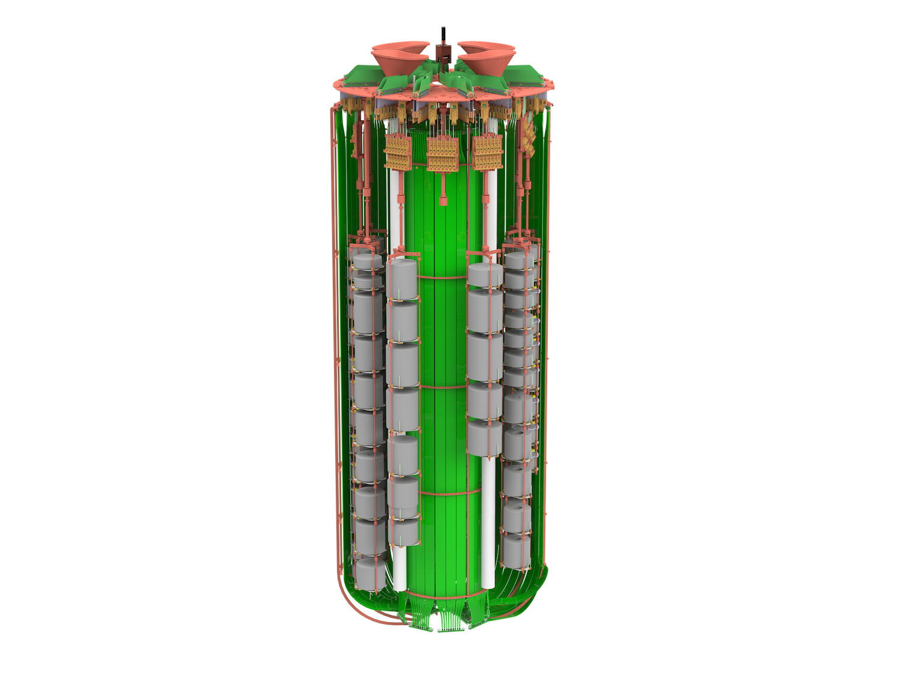
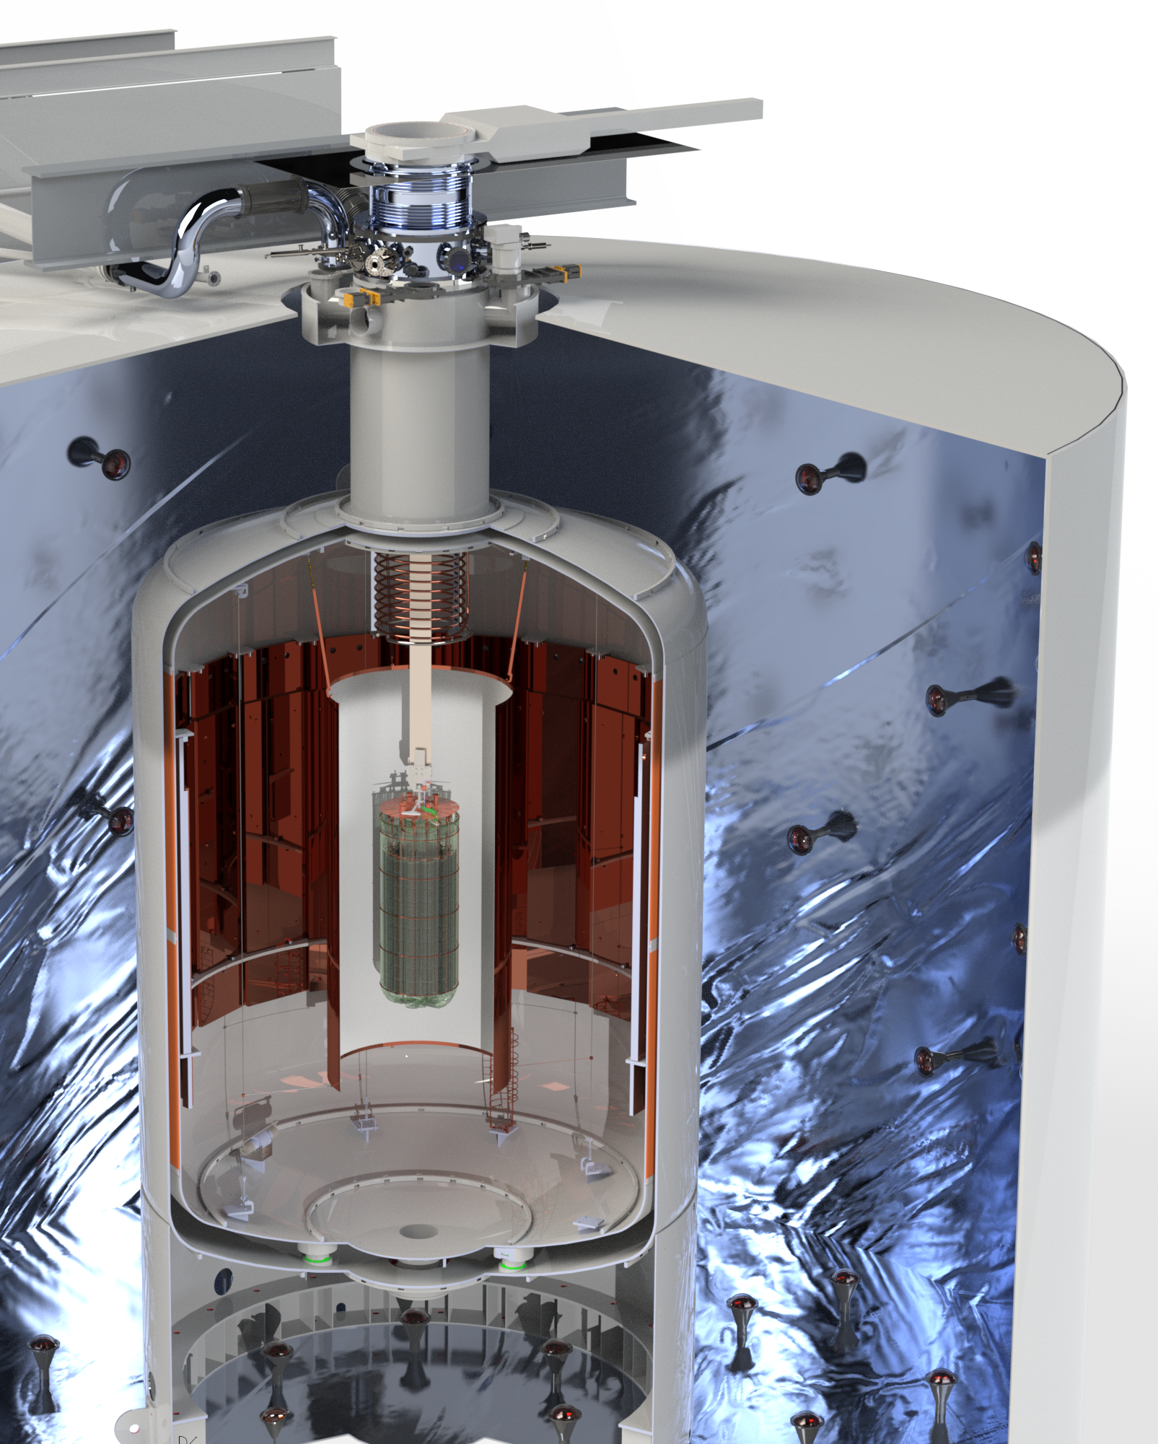
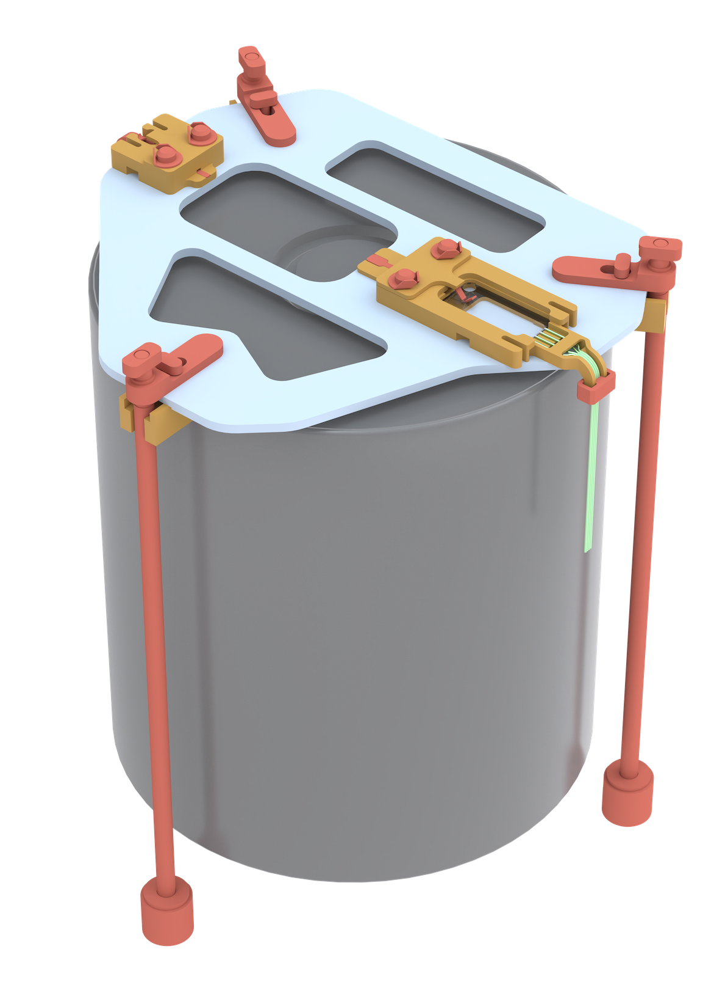

The - 200 Experiment
HPGe readout electronics
Larger mass
(inverted coaxial)
HPGe detectors with up to 4 kg
Water tank/ $μ$-veto
Liquid Argon instrumentation:
inner & outer fiber barrels with silicon photomultiplier (SiPM) readout at top & bottom
Detector mount: underground copper, optically active PEN plates and radiopure PEI
Liquid Argon cryostat
Source funnels
for ²²⁸Th calibration sources
Notes:
Get some more picture from luigis slides

Slide 11
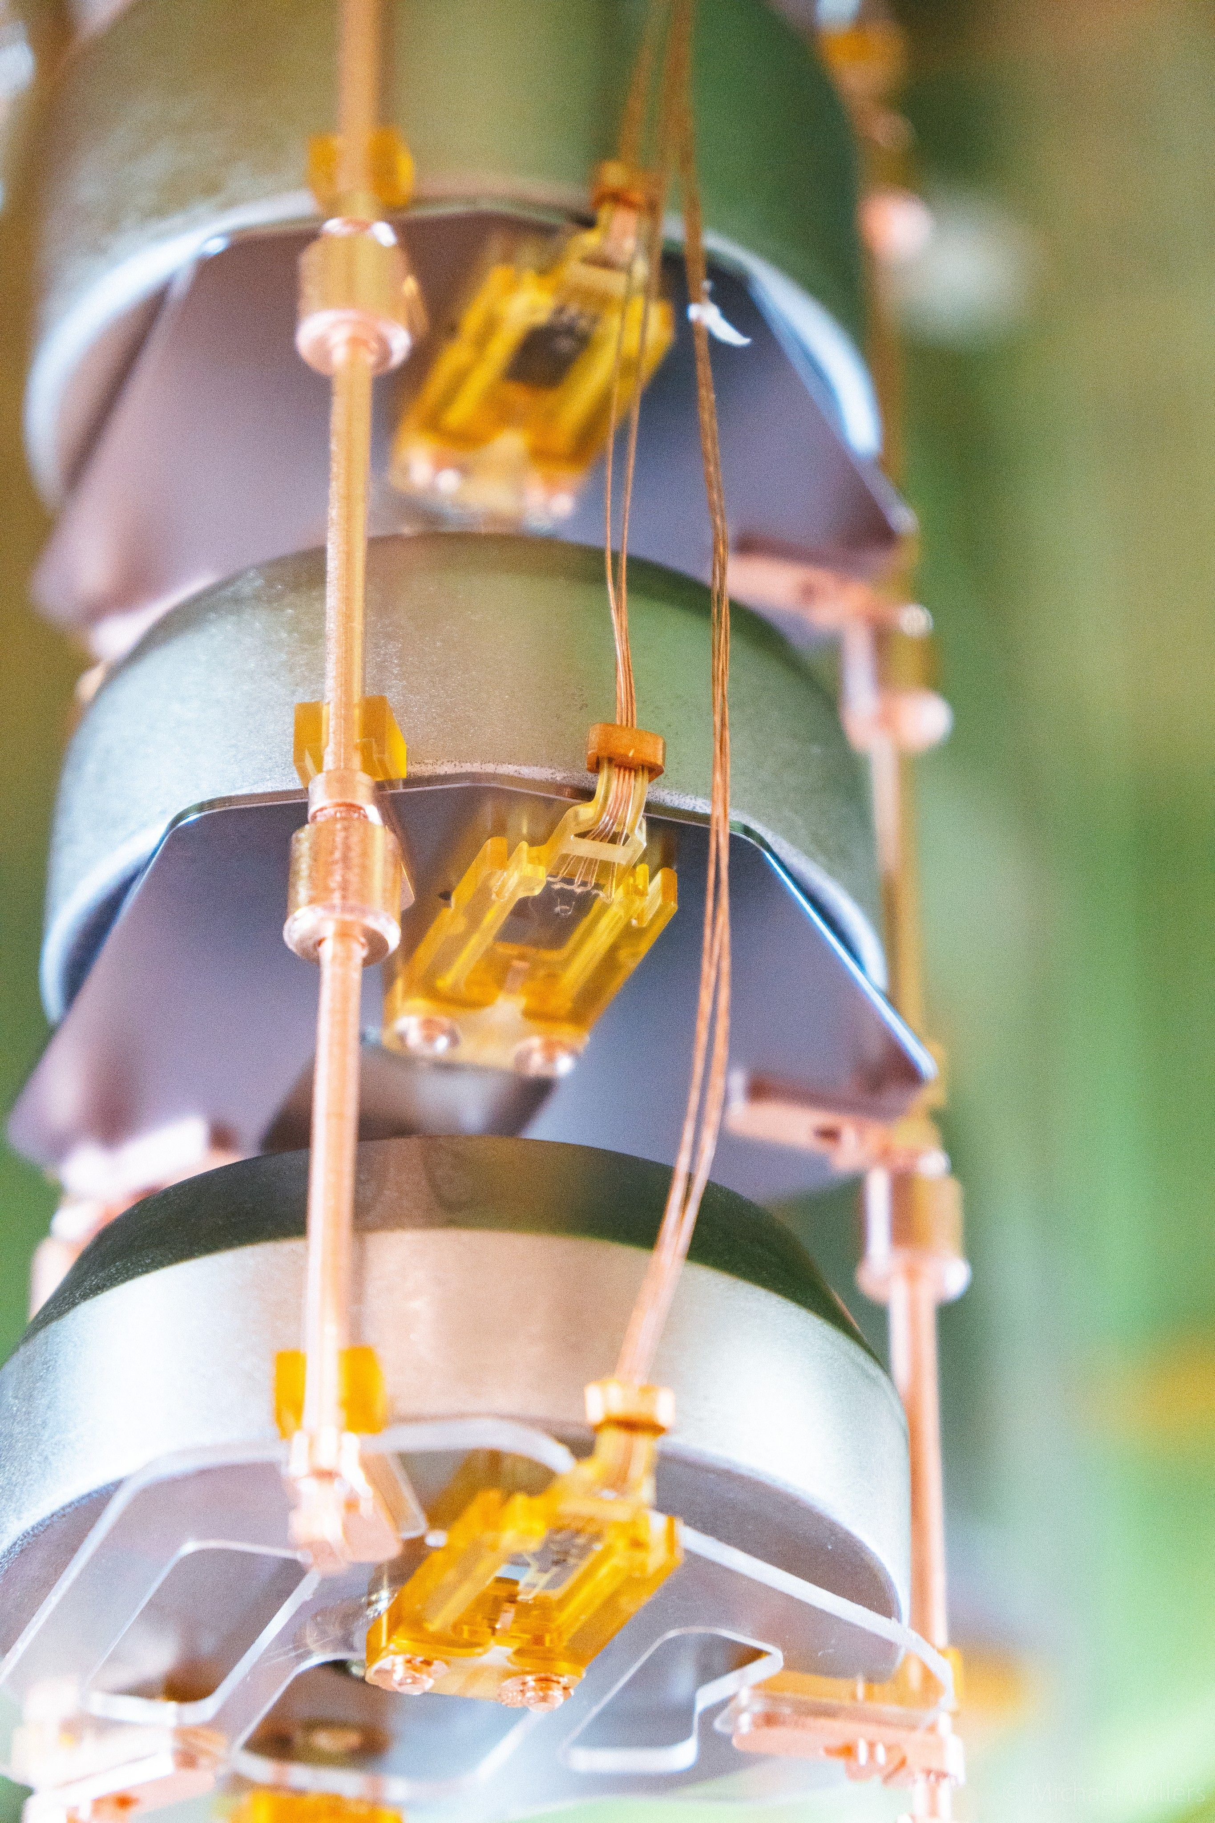
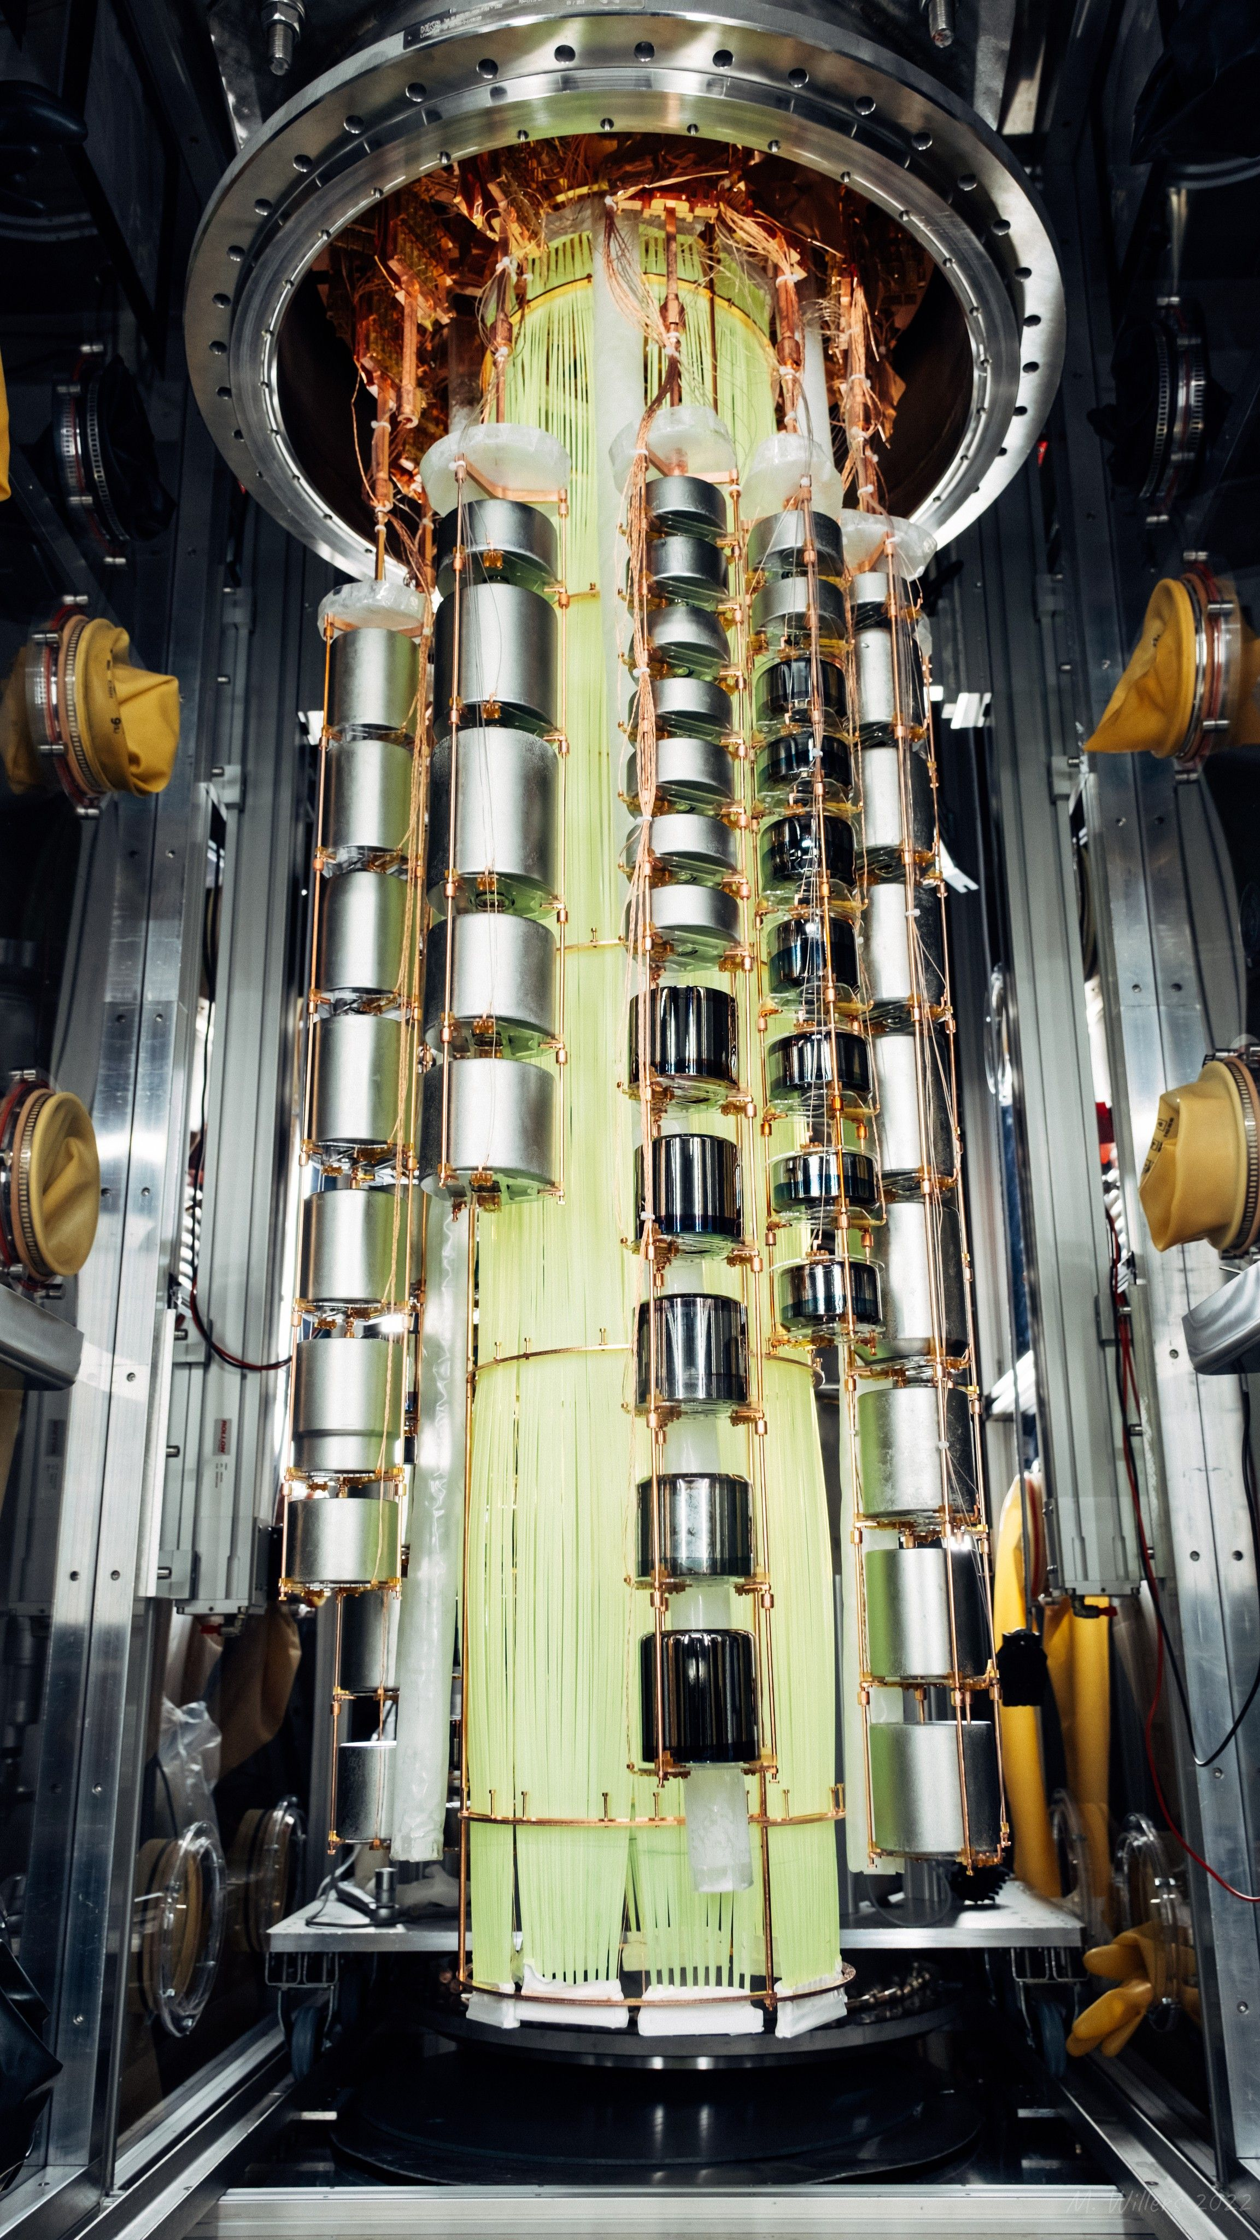
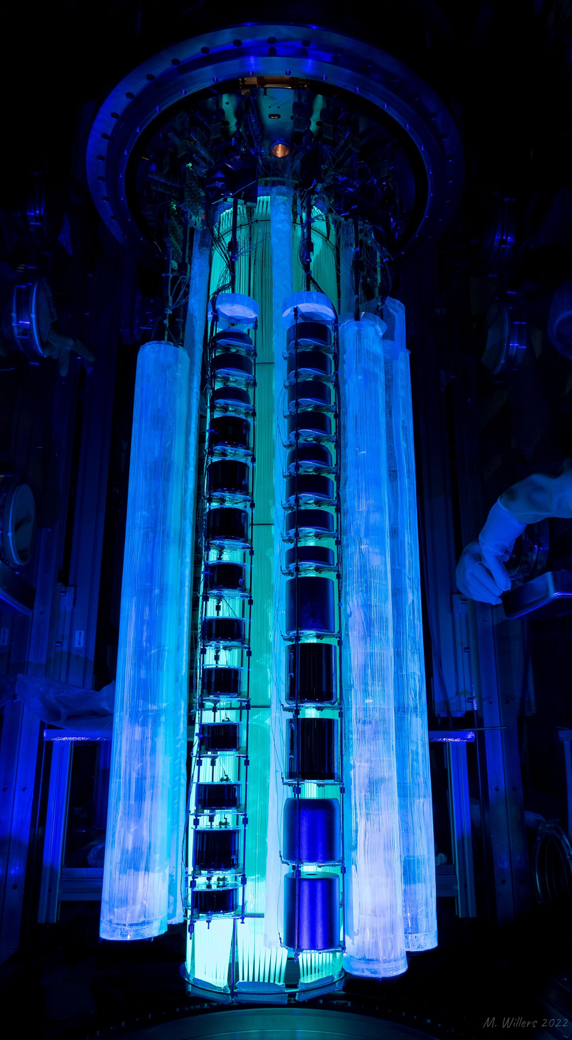
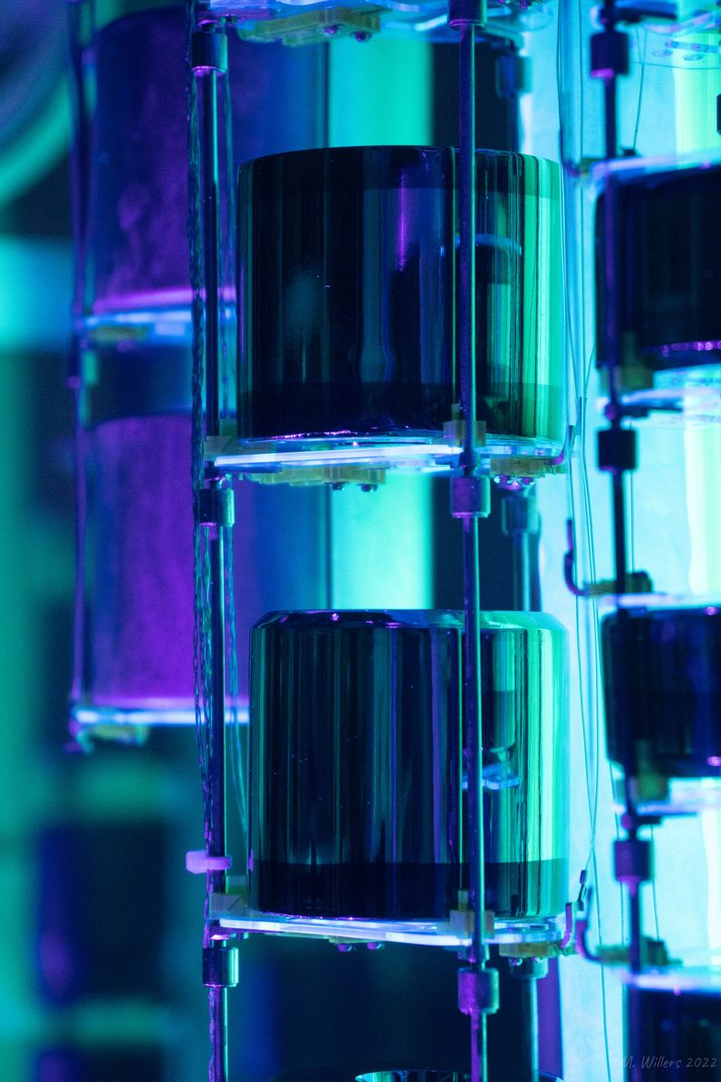

The - 200 Experiment
Background radiation
Liquid Argon cryostat
$$γ$$

Slide 12
Outline
Introduction to LEGEND and 0νββ-decay physics
What is the JuLeAna Software Stack?
Features and highlights in the latest LEGEND analysis
Summary & Outlook

Slide 13


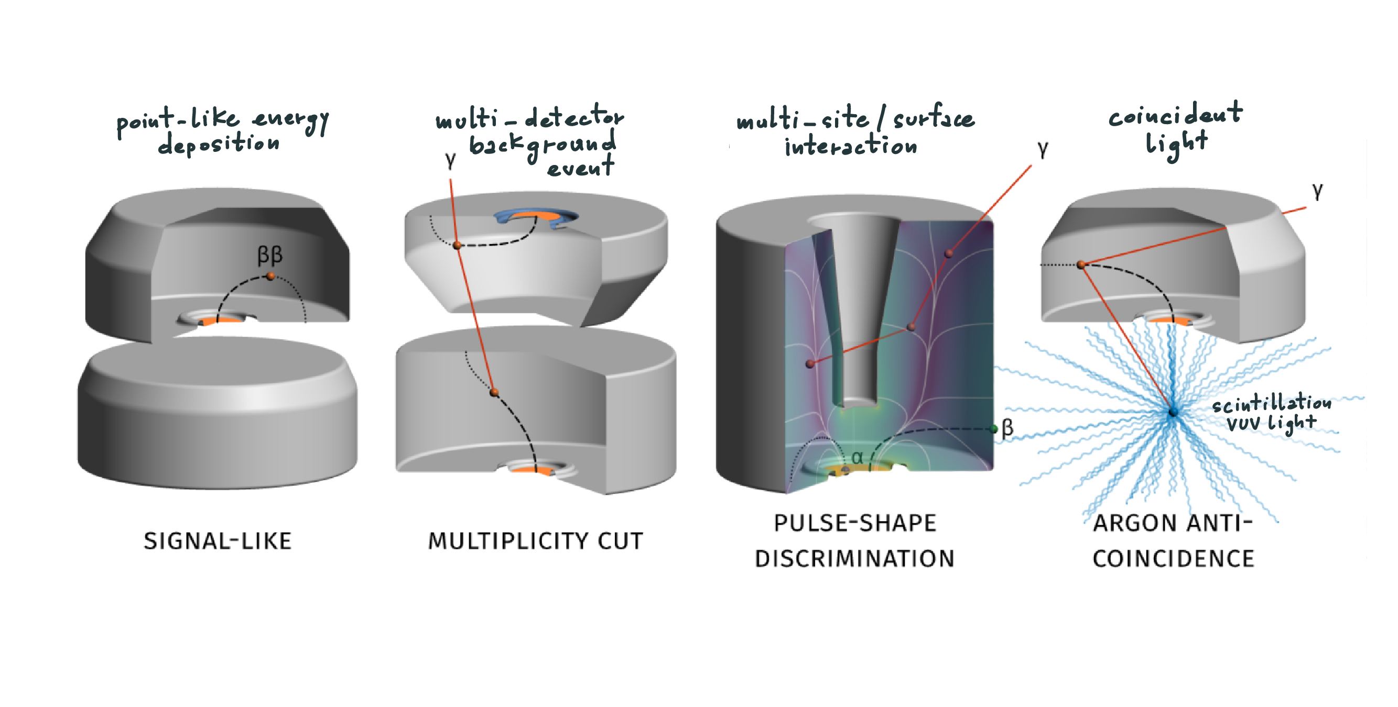
The Analysis Strategy
2 analysis frameworks
New primary software stack in python
Secondary Julia software stack for validation and comparison
&
In blinded analysis

Slide 14
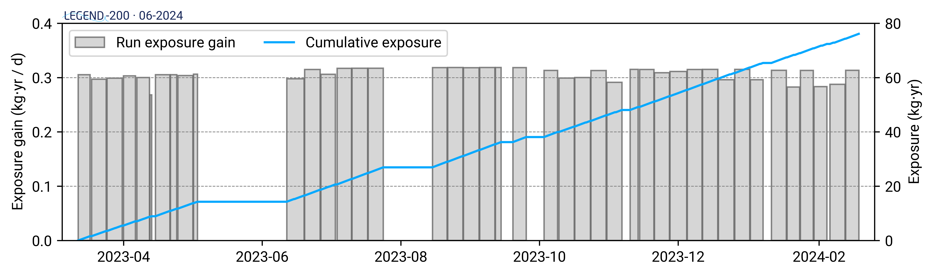
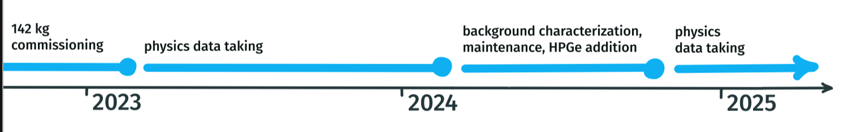
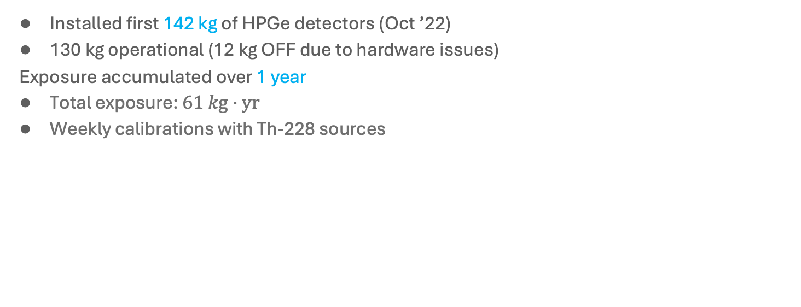
The - 200 Data Taking
Installed first 142 kg of HPGe detectors (Oct ’22)
130 kg operational (12 kg OFF due to hardware issues)
Exposure accumulated over 1 year
Total exposure: $61 kg⋅yr$
Weekly calibrations with Th-228 sources
Latest results:
https://arxiv.org/pdf/2505.10440

Slide 15


The Software Stack
DataTier
ana
sim
raw
dsp
hit
evt
Official
SolidStateDetectors.jl
RadiationDetectorDSP.jl
BAT.jl
-physics
RadiationDetectorSignals.jl
RadiationSpectra.jl
LegendDSP.jl
LegendSpecFits.jl
ZeronuFit.jl
Registry
LegendGeSim.jl
LegendML.jl
LegendEventAnalysis.jl
LegendHDF5IO.jl / LegendDataTypes.jl
IO
LegendDataManagement.jl
Metadata & Pars
legend-julia-dataflow / ParallelProcessingTools.jl
HPC Computing
LegendMakie.jl
Plotting
Notes:
Was ist aktuell im Software Slack?
4 Teile/Kästchen: Daten einlesen (raw), DSP, Fits/SpecFits /Hit, tcm (event building)
4 Kästchen erklären (Alles bildlich darstellen)
Dadrunter die Paketnamen ?
Mostly feature complete for LEGEND analysis …
… but we’ll still add, improve lots of stuff
Covers whole span from Geant4-output and lab control to final analysis

Slide 16
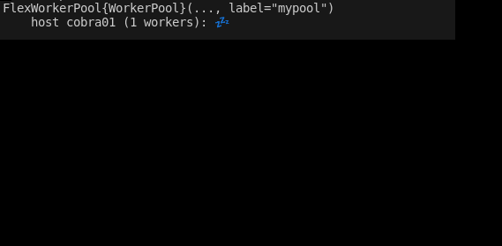
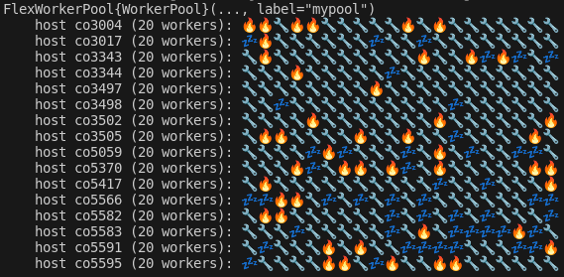


HPC Computing
legend-julia-dataflow / ParallelProcessingTools.jl
HPC Computing
Can scale cluster up and down repeatedly, even from interactive Julia session
Timeout/retry mechanism + atomic file I/O with optional local caching
Best LH5 write performance achieved so far 1.2 TB in 70 seconds
Ran up to 4000 parallel multi-cpu worker processes
Under development: improved distributed progress and performance monitoring
Custom dataflow with simple graph and dependency handling
Markdown log reports and debug plot capabilities
Interactive HPC Computing in a REPL:
All performed on MPCDF Munich HPC systems Raven/Viper

Slide 17
Outline
Introduction to LEGEND and 0νββ-decay physics
What is the JuLeAna Software Stack?
Features and highlights in the latest LEGEND analysis
Summary & Outlook

Slide 18

Analysis workflow overview
waveforms
Legend
raw data
waveform level
detector-wise
file-wise

Slide 19
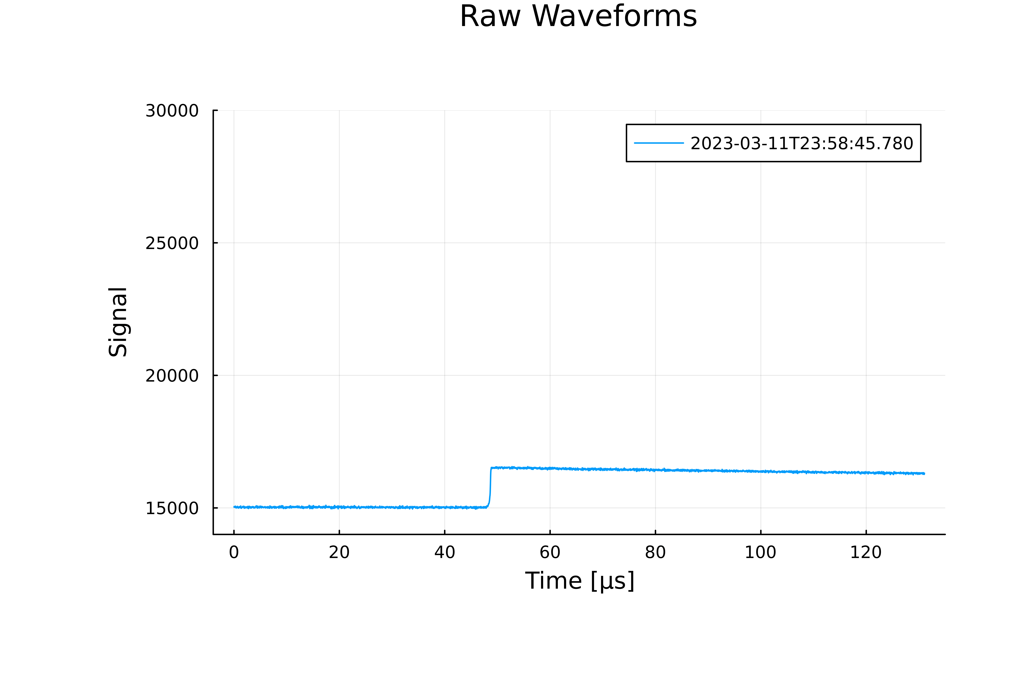
LEGEND Data
LegendHDF5IO.jl / LegendDataTypes.jl
IO
All waveform data saved for offline processing
O (100) of HPGe channels
O (50) of SiPM channels
Metadata in JSON or YAML
raw data in HDF5 with custom compression
julia > using LegendDataManagement, LegendHDF5IO
julia > raw = lh5open(“data.lh5”, “r”)
julia > l200 = LegendData(:l200)
julia > raw = read_ldata(l200, DataTier(:raw), DataPeriod(3), ChannelId(111000))
julia > using CairoMakie, LegendMakie
julia > waveformplot!.(raw.waveform[1:10])
Notes:
7 days of physics data taking
+ Calibration run with 4 Th-228 calibration sources
form a run

Slide 20
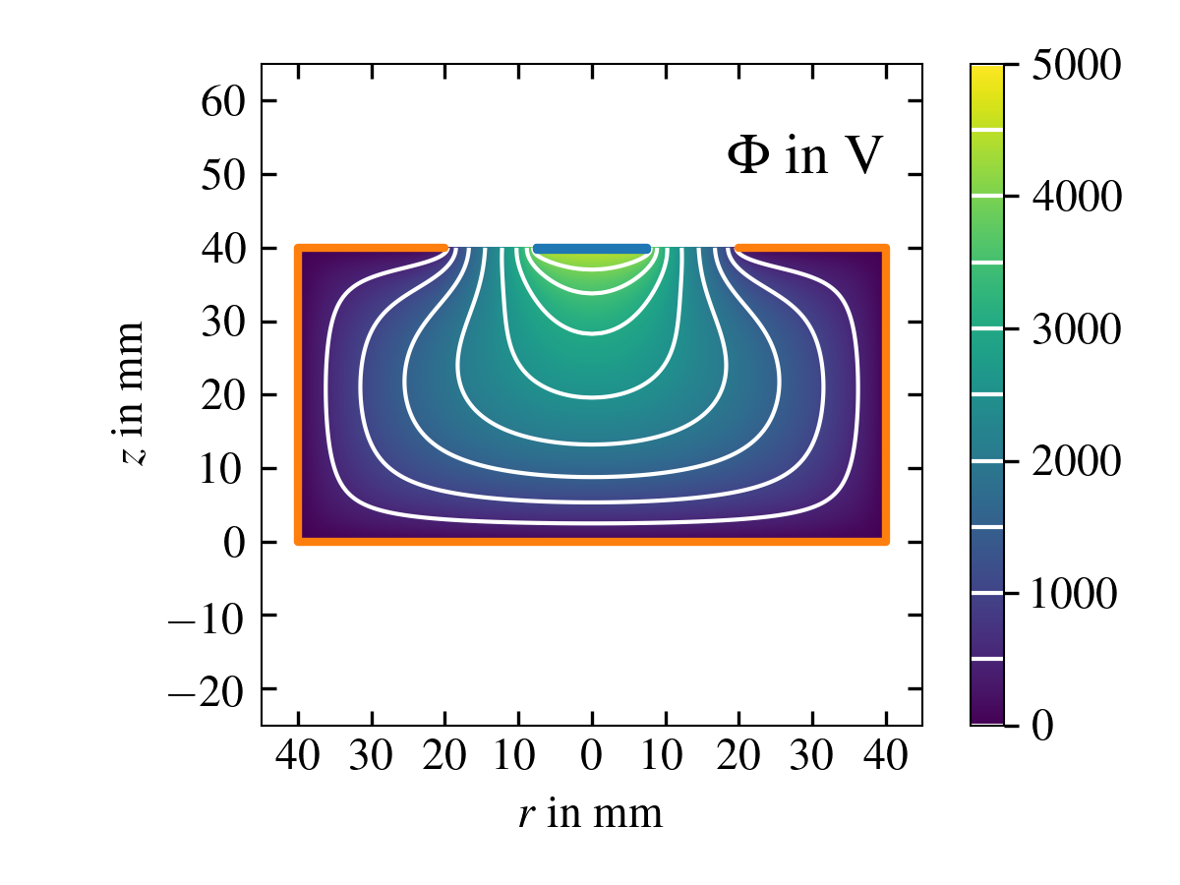
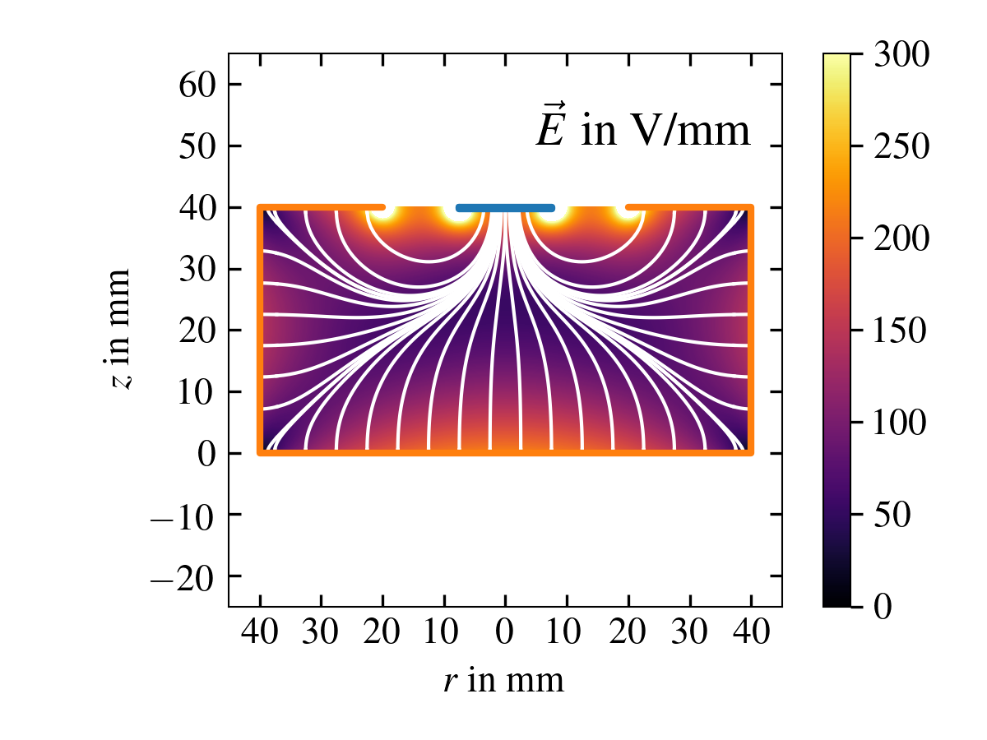
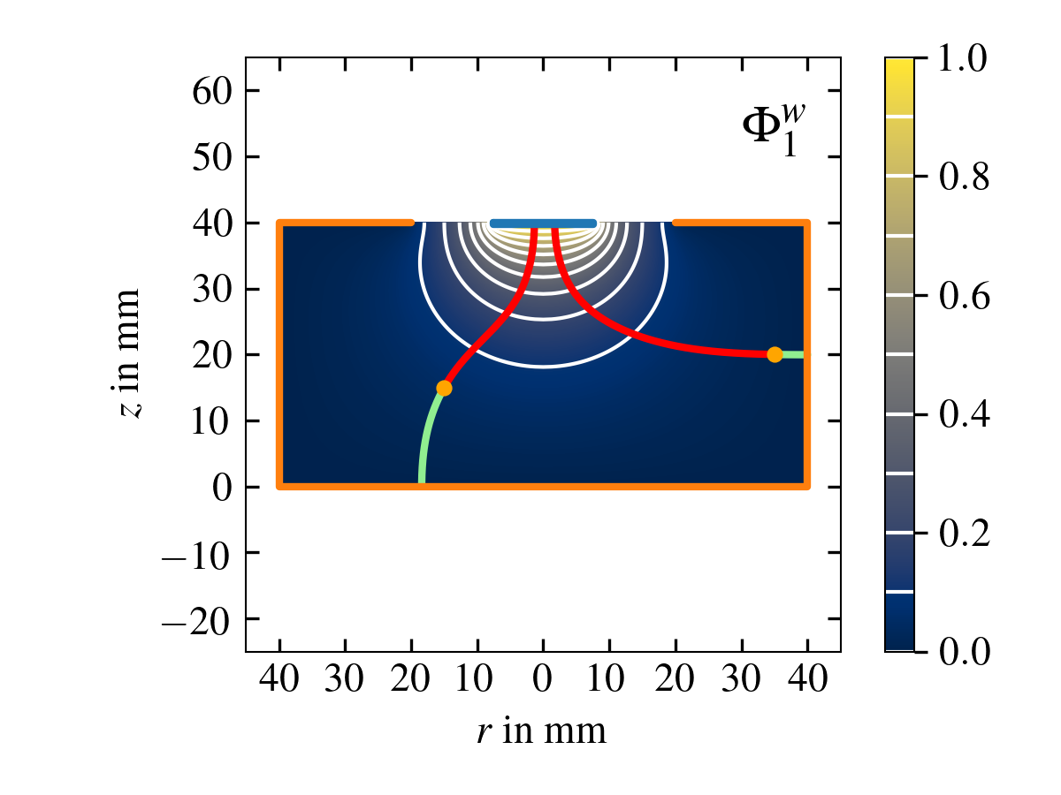
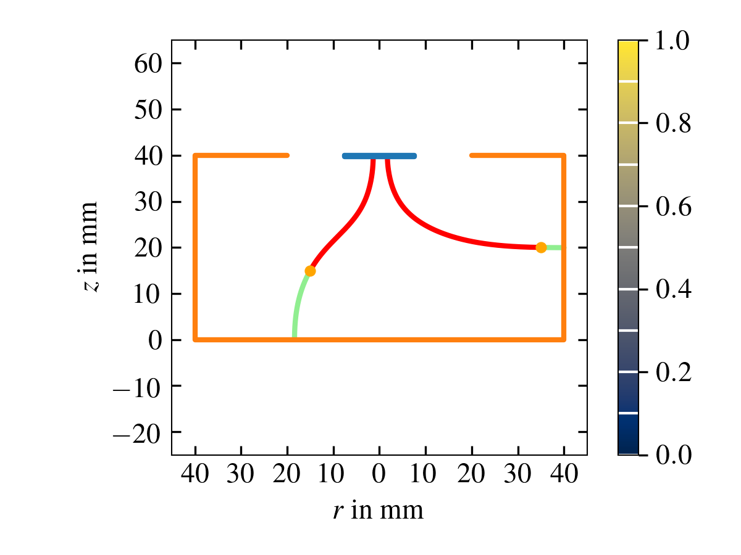
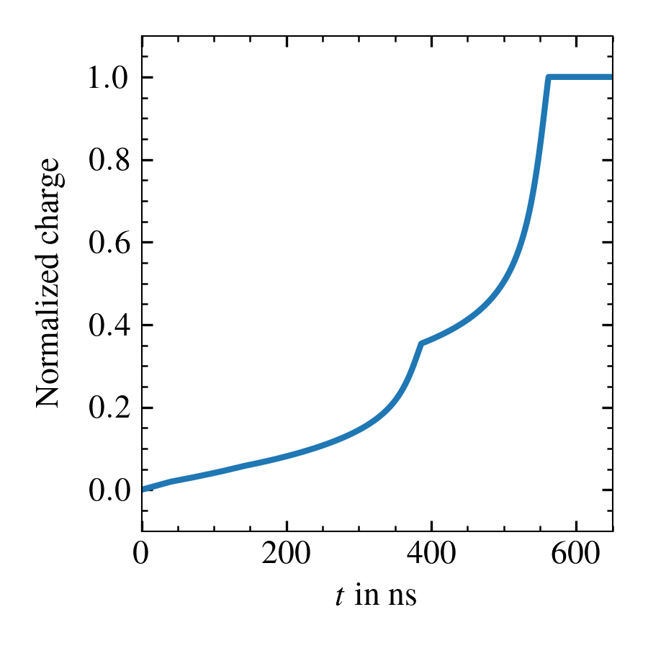
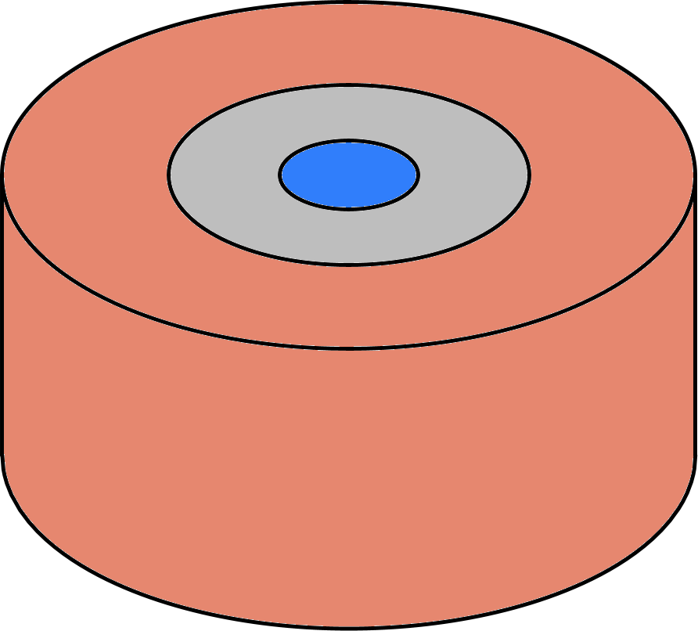

Detector Simulation
SolidStateDetectors.jl
Bias voltage
Charge drift model
Impurity
density
Electric potential
Electric field
Drift paths
Raw pulses
Detector geometry
Weighting potentials
electrons holes
3
Notes:
So let us start with a slide on pulse shape simulation and the different steps to get from the detector geometry and crystal properties to “raw simulated pulses”.
As this is an SSD talk, I will also show the julia commands that are used to perform the different steps of the pulse shape simulation chain on the right.
To start the simulation, the user has to define the detector setup. Let us assume that our detector geometry is defined in a configuration file called, for example, “BEGe.yaml”.
This files contains information like the physical dimensions of the crystal, the geometries of the contacts, possible boreholes, etc. We will have a closer look at the structure of such a configuration file at the end of my talk.
In this file, (*PUSH*) the user can also define the impurity density profile of the detector, the potentials applied to the contacts to bias the detector, and any object in the vicinity of the detector (holding structures, cryostat walls and so on) that have an influence on the electric potential (if SSD should include them in the simulation).
SSD calculates the electric potential from all that information using a successive over relaxation algorithm. The implementation of this algorithm is optimised for fast computation AND we recently added support for performing the calculations on GPUs for further speed-up. I should note here that SSD can perform both 2D AND 3D calculations of the electric potential. Especially, 3D simulations can be quite important to simulate detectors or setups which are not fully phi-symmetric (segmented surfaces, non-centered boreholes, holding structures, etc.).
The first derivative of the electric potential then gives the electric field.
To simulate the drift paths of the charges created in an event with given hit positions and energies, SSD needs the electric field and a charge drift model for both electrons and holes. The energy deposits are converted to electron-hole pairs that then drift according to the electric field and the charge drift model in pre-given time steps of e.g. 1 ns.
Together with the weighting potentials, that are defined by the detector geometry, we can apply the Schockley-Ramo theorem to calculate the raw pulses to which we could later apply an electronics model to obtain the “real” pulses (but especially applying an electronics model is not part of SSD).
And as said, these simulated pulses can then be used to test pulse shape discrimination algorithms.
While this might sound very trivial there are quite some uncertainties on the input to the simulation and that will influence the outcome.

Slide 21
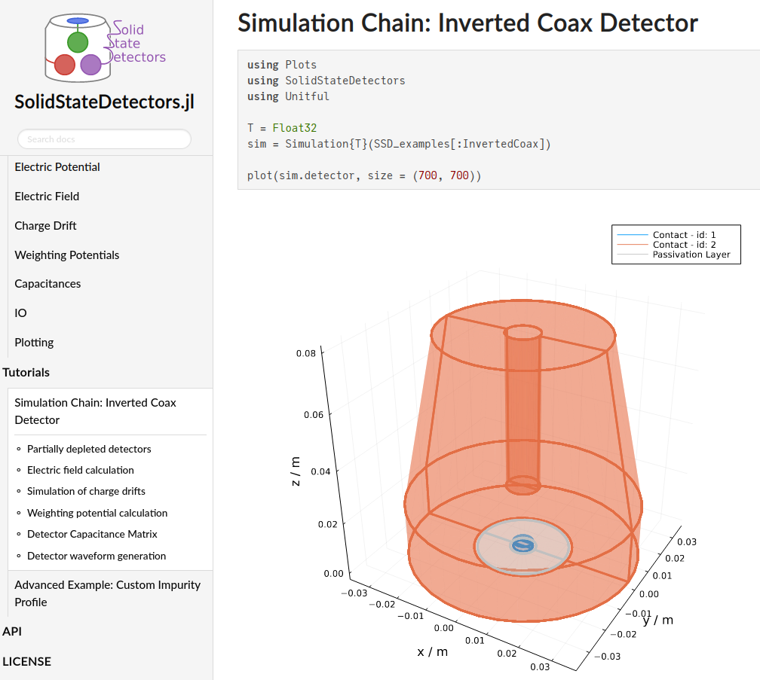


SolidStateDetectors.jl on GitHub
Find the latest version of the documentation on GitHub:
https://juliaphysics.github.io/ SolidStateDetectors.jl/stable/
36

Slide 22
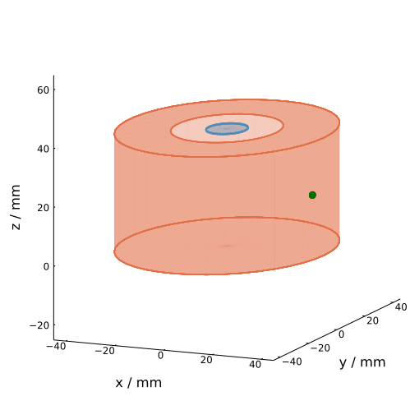
Simulating Group Effects
SolidStateDetectors.jl
julia > using SolidStateDetectors, Unitful
julia > sim = Simulation{Float64}(“BEGe.yaml”)
julia > calculate_electric_potential!(sim)
julia > calculate_electric_field!(sim)
julia > for i in 1:2 calculate_weighting_potential!(sim, i) end
julia > locations = [CartesianPoint(0.035,0,0.02)] julia > energies = [1000u”keV”]
julia > evt = Event(NBodyChargeCloud(locations, energies, 100)) julia > simulate!(evt, sim, diffusion = true, self_repulsion = true)
40

Slide 23
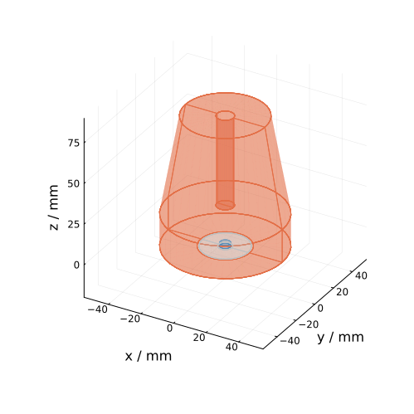
Support for Geant4.jl
SolidStateDetectors.jl
julia > using SolidStateDetectors, Unitful julia > using Geant4
julia > sim = Simulation{Float64}(“ivc.yaml”)
julia > simulate!(sim)
41

Slide 24
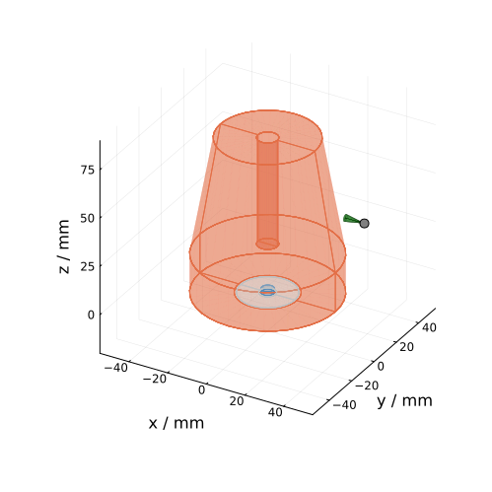
Support for Geant4.jl
SolidStateDetectors.jl
julia > using SolidStateDetectors, Unitful julia > using Geant4
julia > sim = Simulation{Float64}(“ivc.yaml”)
julia > simulate!(sim)
julia > source = MonoenergeticSource(
“gamma”, 2.615u”MeV”, CartesianPoint(0.05, 0.0, 0.05), CartesianVector(-1, 0, 0), 10u”°”
)
41

Slide 25

Support for Geant4.jl
SolidStateDetectors.jl
julia > using SolidStateDetectors, Unitful julia > using Geant4
julia > sim = Simulation{Float64}(“ivc.yaml”)
julia > simulate!(sim)
julia > source = MonoenergeticSource(
“gamma”, 2.615u”MeV”, CartesianPoint(0.05, 0.0, 0.05), CartesianVector(-1, 0, 0), 10u”°”
)
julia > app = G4JLApplication(sim, source) julia > evts = run_geant4_simulations(app, 10000)
41

Slide 26

Support for Geant4.jl
SolidStateDetectors.jl
julia > using SolidStateDetectors, Unitful julia > using Geant4
julia > sim = Simulation{Float64}(“ivc.yaml”)
julia > simulate!(sim)
julia > source = MonoenergeticSource(
“gamma”, 2.615u”MeV”, CartesianPoint(0.05, 0.0, 0.05), CartesianVector(-1, 0, 0), 10u”°”
)
julia > app = G4JLApplication(sim, source) julia > evts = run_geant4_simulations(app, 10000)
julia > simulate_waveforms(sim, evts)
41

Slide 27
Analysis workflow overview
waveforms
data
quality cuts
Legend
raw data
Remove non-physical waveforms
waveform level
detector-wise
file-wise

Slide 28

Quality Cuts: Identify non-physical Events
LegendML.jl
Machine Learning
based QC:
Affinity Propagation with Support Vector Machine
Re-labeling by hand with interactive Pluto.jl notebooks during shifts
Notes:
7 days of physics data taking
+ Calibration run with 4 Th-228 calibration sources
form a run

Slide 29
Analysis workflow overview
waveforms
data
quality cuts
digital signal processing
(dsp)
Remove non-physical waveforms
filter to extract parameters, e.g. energy
Legend
raw data
waveform level
detector-wise
file-wise

Slide 30




Digital Signal Processing
LegendDSP.jl
RadiationDetectorDSP.jl
First step in analysis chain
Signal height : Energy information
Signal derivative: Pulse Shape information
Signal integral: Charge-trapping information
Time points: Drift Information
Custom GPU-accelerated DSP routines
julia > using LegendDSP
julia > dsp = dsp_icpc(raw, DSPConfig(“config.json”), 400.0u”µs”, PropDict(:trap => (:rt => 10.0u”µs”, :ft => 3.0u”µs”)))
Notes:
7 days of physics data taking
+ Calibration run with 4 Th-228 calibration sources
form a run

Slide 31
Analysis workflow overview
waveforms
data
quality cuts
digital signal processing
(dsp)
energy calibration
(ecal)
Remove non-physical waveforms
filter to extract parameters, e.g. energy
Fit calibration data: γ-lines with known energies
Legend
raw data
dsp parameter level
waveform level
detector-wise
file-wise
run-wise

Slide 32


Th-228 Calibration Spectra
LegendSpecFits.jl
RadiationSpectra.jl
julia > using LegendSpecFits, LegendMakie
julia > r_simple, p_simple =
simple_calibration(e_uncal,
th228_lines, th228_windows)
julia > lplot(p_simple)
DEP
Bi-212 FEP
SEP
FEP

Slide 33



Peak Fits
LegendSpecFits.jl
RadiationSpectra.jl
Signal (γ)-line peak: Gaussian
mean: µ
standard deviation: std
amplitude: n
Low-energy tail: Exponentially modified Gaussian
width skew width
rel. amplitude: skew fraction
Background:
Energy-independent (flat) background
Step-function $→$ Compton continuum
4. High energy tail:
for escape peaks only: Compton scattering of annihilation photon in transition layer
Bayesian Guided MLE fits
_________________________
very small + not significant
-> reduce residuals to literature value
julia > r_fits, p_fits = fit_peaks(peakhists, peakstats, th228_names)
julia > lplot(p_fits)

Slide 34



Energy Calibration
LegendSpecFits.jl
RadiationSpectra.jl
Performed per run and per detector
Literature values with uncertainties
Linear $χ^{2}$fit
Excellent residuals
peak centroid =
julia > r_cal, p_cal = fit_calibration(1, r_fits.centroid, th228_lines)
julia > lplot(p_cal)

Slide 35


Energy Resolution
LegendSpecFits.jl
RadiationSpectra.jl
Numerical FWHM of signal components
√ of 1st-order
polynomial $χ^{2}$fit
Excellent residuals
Literature values with uncertainties
julia > r_fwhm, p_fwhm = fit_fwhm(1, th228_lines, r_fits.fwhm)
julia > lplot(p_fwhm)

Slide 36

Energy Resolution
LegendSpecFits.jl
RadiationSpectra.jl
Current LEGEND-200 Dataset:
47 calibration runs
89 HPGe usable detectors
6 different energy extractors
→ More than 25,000 spectra auto-calibrated (!)

Slide 37
Analysis workflow overview
waveforms
data
quality cuts
digital signal processing
(dsp)
energy calibration
(ecal)
pulse-shape analysis (psd)
Remove non-physical waveforms
filter to extract parameters, e.g. energy
Fit calibration data: γ-lines with known energies
Remove
background events
Legend
raw data
dsp parameter level
waveform level
detector-wise
file-wise
run-wise

Slide 38


The A/E Classifier to Discriminate SSEs and MSEs
SSE
MSE
A: maximum current amplitude of event
E: height of charge pulse
→ only applicable in ICPC, PPC and BEGe detectors
Notes:
- “The A/E classifier is a PSD classifier that can distinguish between signal-like single-site events (SSEs) and background-like multi site events (MSEs) based on the charge and current signal of the events.”
Detetcor and run/partition specific
– determine cut value below everything is rejected (low A/E cut) and a certain value like 3 or 9 above all events are rejected (high A/E cut)
Discriminate between SSEs and MSEs based on charge and current signal. Current is derivative of charge and has several peaks for MSEs -> maximal current pulse is lower compared to the signle current pulse we get from an event with same energy (plus charge signal i.e. waveform has multiple kinks for MSEs)

Slide 39



Pulse Shape Discrimination
LegendSpecFits.jl
RadiationSpectra.jl
Double Escape Peak (DEP) as proxy for Single Site Events (SSE)
→ Fully automated cut generation
p⁺ events
DEP
SSEs
SEP
FEP
MSE and n⁺ events
Notes:
7 days of physics data taking
+ Calibration run with 4 Th-228 calibration sources
form a run

Slide 40


Pulse Shape Discrimination - A/E
LegendSpecFits.jl
SEP
Current LEGEND-200 Dataset:
3 different A/E extractors
→ More than 12,000 auto-tuned cuts (!)
julia > r_sf, p_sf = get_peak_surrival_fraction(
aoe, e, 2103u”keV”, 20.0u”keV”, -2.0)
julia > lplot(p_sf)

Slide 41
Analysis workflow overview
waveforms
data
quality cuts
digital signal processing
(dsp)
energy calibration
(ecal)
pulse-shape analysis (psd)
event building
Put everything together:
- Germanium dets
- LAr
- all cuts
Remove non-physical waveforms
filter to extract parameters, e.g. energy
Fit calibration data: γ-lines with known energies
Remove
background events
Legend
raw data
dsp parameter level
cal. energy spectrum
waveform level
detector-wise
all LEGEND instrumentation
file-wise
run-wise
partition-wise

Slide 42



SiPM Calibration
LegendSpecFits.jl
julia > r_si, p_si = sipm_simple_calibration(e_uncal)
julia > lplot(p_si)
julia > r_fit, p_fit = fit_sipm_spectrum(
r_si.pe_simple_cal, 0.5, 3.5)
julia > lplot(p_fit)
julia > r_cal, p_cal = fit_calibration(
1, r_fit.positions, 1:1:3)
julia > lplot(p_cal)
Gaussian Mixture Model
→ Effective Peak Positions
*9 SiPMs/channel

Slide 43


Event Building
Software trigger condition:
Any{Energy_{HPGe}} > 25keV && waveform passes QC
Physical event condition:
All{HPGe_{No-Trigger}} == “Baseline-Only”
LAr anti-coincidence:
Sum{Energy_{SiPM}} > 4 PE
Define Anti-Coincidence
Number{Trigger_{HPGe}} == 1
Define PSD cut
All{HPGe_{Trigger}} == Single-site events
LegendEventAnalysis.jl
Custom software trigger and event reconstruction with all three detector subsystems
⁴⁰K
⁴²K
²⁰⁸Tl
²¹²Bi
α-events

Slide 44
Analysis workflow overview
waveforms
data
quality cuts
digital signal processing
(dsp)
energy calibration
(ecal)
pulse-shape analysis (psd)
event building
0νββ analysis
Put everything together:
- Germanium dets
- LAr
- all cuts
Remove non-physical waveforms
filter to extract parameters, e.g. energy
Fit calibration data: γ-lines with known energies
Remove
background events
T_{1/2 ,}
background index
Legend
raw data
dsp parameter level
cal. energy spectrum
waveform level
detector-wise
all LEGEND instrumentation
file-wise
run-wise
partition-wise

Slide 45




Data in the Region of Interest
ZeronuFit.jl
7 events surviving in LEGEND-200 ROI:
Background Index
$$BI={0.5}_{- 0.2}^{+0.3} cts/(kev⋅kg⋅ton)$$
GERDA, MAJORANA + LEGEND combined
LEGEND-200 contribution
+30% of limit median expectation
event at 1.4 𝜎 from 𝑄_{ββ} weakens limit
Observed | Sensitivity
$$>1.9⋅{10}^{26} yr$$ | $$2.8⋅{10}^{26} yr$$

Slide 46
Outline
Introduction to LEGEND and 0νββ-decay physics
What is the JuLeAna Software Stack?
Features and highlights in the latest LEGEND analysis
Summary & Outlook

Slide 47
Summary & Outlook
And of course we have T-shirts
LEGEND features full Julia based Software Stack
LEGEND tools will become more and more JuliaPhysics tools, e.g. SolidStateDetectors.jl to be used by the community
Julia ecosystem demonstrates its versatility and power for fast and easy scaling
High acceptance by new students and beginners due to simplicity of code, software and API layout

Slide 48

0νββ Decay Physics with ⁷⁶Ge

Slide 49
BACKUP

Slide 50
Role of Julia Software Stack
Primary LEGEND software stack in Python, alternative in Julia
Validation: Independent code guards physics results against bugs in primary stack
Experimentation: Primary stack needs stable interface, alternative can use bleeding-edge technology and change/evolve more freely
Future perspective: Find out what’s possible for LEGEND-1000
Community-wide and LEGEND-specific open-source packages
Custom dataflow and management routines for throughput cluster computing
raw
dsp
hit
evt

Slide 51











Background Reduction Strategy
MJD, GERDA, LEGEND
ββ decay signal: single-site event energy deposition in a ~1 mm³ volume
Liquid Ar
Ge detector anti-coincidence
MJD, GERDA, LEGEND
MJD, GERDA, LEGEND
$$γ$$
$$ββ$$
Muon veto based on Cherenkov light and plastic scintillator
LAr veto based on
Ar scintillation light
read-out by fibers
MJD, GERDA, LEGEND
GERDA, LEGEND
$$γ$$
$$ββ$$
$$γ$$
$$β$$
Pulse shape discrimination (PSD) for multi-site and surface events
Scintillating PEN
plate detector holders
MJD, GERDA, LEGEND
$$α$$
PEN
LEGEND
$$γ$$
Fibers
Pure water
$$ν$$
$$μ$$
$$ν$$

Slide 52




Sensitivity
$\left\langle m_{ββ}\right\rangle$: Effective Majorana mass
$T_{1/2}^{0ν}$: Decay half-life
$M^{0ν}$: Nuclear matrix element
$G^{0ν}$: Phase space factor
$$\left\langle m_{ββ}\right\rangle ∝\frac{1}{g_{A}^{2} |M^{0ν}|}\sqrt{\frac{1}{T_{1/2}^{0ν} G^{0ν}}}$$
“…an era in which a discovery could come at any time!”

Slide 53


LEGEND Experiment

Slide 54


The - 1000 Experiment

Slide 55
Th-228 Calibration Spectra
julia > using LegendSpecFits, LegendMakie
julia > r_simple, p_simple =
simple_calibration(e_uncal,
th228_lines, th228_windows)
julia > lplot(p_simple)

Slide 56


A/E Digital Signal Processing

Slide 57


Energy Dependence of Raw A/E
“high A/E region”
Model energy-dependence with:
SSE band
“low A/E region”
Notes:
Savitzky golay filter for A/E, cusp filter for energy
Then normalize A/E to get values around 1
2D histogram (explain it -> every point is one event that has a certain A/E value, x axis energy)
Explain different A/E zones i.e. high A/E (close to surface??), low A/E (MSE) and SSE band
-> SSEs: populate gaussian shaped peak with mean mu and standard deviation sigma
Normalized and calibrated A/E classifier is to be centered around 0 and should have standard deviation of 1

Slide 58

Definition of Compton Bands and Fit
GitHub: fit_aoe_compton
Divide Compton continuum: 47 bands
Each band 20 keV range
From 520 keV – 2170 keV
Fit function:
EMG:
Notes:
EMG Formel ausschreiben

Slide 59





Combined Fit
GitHub: fit_aoe_compton_combined
Combined Bayesian-guided MLE fit
Notes:
MLE = Maximum Likelihood Estimation (Bayesian guided -> pseudo priors), starting values from single fits
Frequentist fit aber nutze Konzept von Priorn um Fitter zu guiden (fügen Prior Knowledge ein aber haben trotzdem kompletten Frequentist fit)
Take mu and sigma values of each CB as pseudo priors for optimization of a combined neg log likelihood
Visualize this -> e.g. bubble around three single CB fits to indicate that all CB together are used to determine the ‘optimal’ fit parameters (not every single CB optimized itself but all together)

Slide 60


Energy Correction
Notes:
Result: mu and sigma value for every CB -> fit these distributions with the mu and sigma functions to obtain the values for correcting for the energy dependence
This method “individual fits”, since all CB are fitted individually. But: prone to outlayers that could influence the result negatively
Therefore: new method was developed: the combined fit
Combined fit: residuals are 0 (no single points anymore)

Slide 61




Charge Trapping Correction (CTC)
GitHub: ctc_aoe
Fit function:
CTC based on Compton bands:
Proportional to Charge trapping
Notes:
Auf Basis der Compton Bänder und nicht DEP (Unterschied zu Pygama)
Numerische Optimierung ctc

Slide 62

Charge Trapping Correction (CTC)
Notes:
Effect of CTC
Higher drift time means lower A/E which we don‘t want since it could be leading to the rejection of a signal-like event

Slide 63


Tuning of Low A/E Cut and the High A/E Cut
GitHub: get_low_aoe_cut
Low A/E: 90% SF of Tl208DEP
High A/E: cut off at 3 (or 9)
Notes:
How to tune low A/E?
Swipe through DEP distribution and reject everything below it until we reach 90% SF since events in the DEP window should me mostly due to SSEs

Slide 64
Survival Fractions after Low and DS A/E Cut
GitHub: get_peak_survival_fraction
LOW
DS

Slide 65

Application of A/E Cut on Calibration Spectrum

Slide 66

SiPM Analysis – LAr Cut
4x4 classifier
LAr anti-coincidence cut
in [-1µs, 5µs] around t0*
*(After discharge removal per SiPM trigger)
Total LAr Efficiency
94.29 ± 0.001 %*
*(Based on forced-trigger after DC removal)

Slide 67


SiPM Analysis – LAr Cut

Slide 68







LAr anti-coincidence cut
Before
After
LAr anti-coincidence
⁴²K
Liquid Ar
$$β$$
$$γ$$
⁴²K
$$β^{−}$$
⁴²K
$$γ$$
⁴⁰K
⁴⁰K
$$γ$$
⁴⁰K
⁴⁰K
EC
Fibers
$$γ$$
Energy (keV)
Notes:
Small graphics for potassium peaks
Monitoring plot with bigger font

Slide 69

Muon Veto Analysis – DSP + Calibration
Custom DSP routines
Calibration based on 1 P.E. peak fit
Muon veto flag
Multiplicity > 12 || Sum(PE) > 30 P.E*
*(in [-10µs, 10µs] around t0)

Slide 70



Muon Veto Analysis

Slide 71

LEGEND Experiment

